Slide 1


Project 1: “Employment impact of COVID-19 in hotel occupancy, during the holy week in Mexico”
Team:
The anacondas
Daniela Villarreal Murillo
Juan Ramón Félix Alvarez Tostado
Raúl Flores Palacios
Michelle García Sanchéz

Slide 2
Hypothesis
With less arrivals of tourist during holy week of 2020 we estimate that at least there has been an impact of 50% on hotel occupation, that will translate to unemployment rate due to less demand .

Slide 3
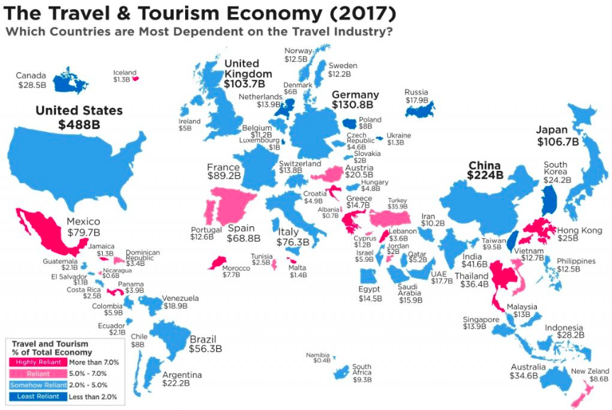
> 9%
Of the Mexican GDP
OCDE countries are 4.7% average
Tax Collection is close to 14% of GDP

Slide 4
Identify data sources
Build Data Retrieval Plan
Assemble and clean
Acknowledge limitations
02
04
06
08
Make the call or tell the story
Decompose the ask
Define strategic metrics
Retrieve the data
Analyze trends
01
03
05
07
09
How we run the project

Slide 5
01. Decompose the ask

Slide 6
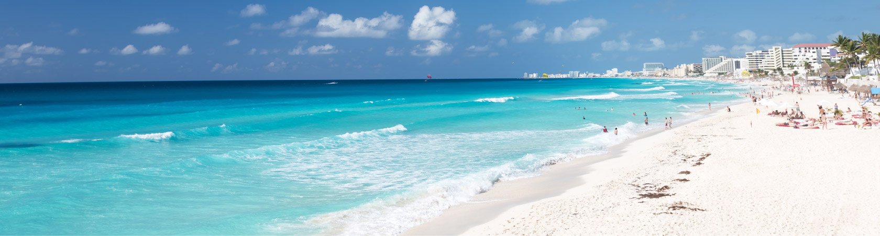
TOURISM IN MEXICO
THE ASK: How the employment in tourism in Mexico, during holy week 2020, was impacted by unpredicted events (COVID-19). From perception to real facts supported by data.
9%
4.5 Million
8.9%
Of the Mexican economy
Annual Employment on the Tourism Sector
Of the direct employments of the country
Define an index for calculation of unemployment based on occupancy rates

Slide 7
02. Identify data sources

Slide 8
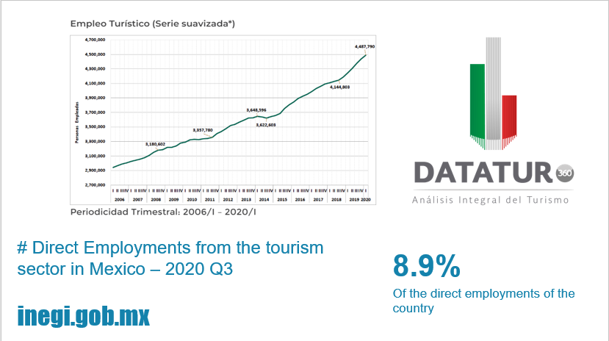

Slide 9
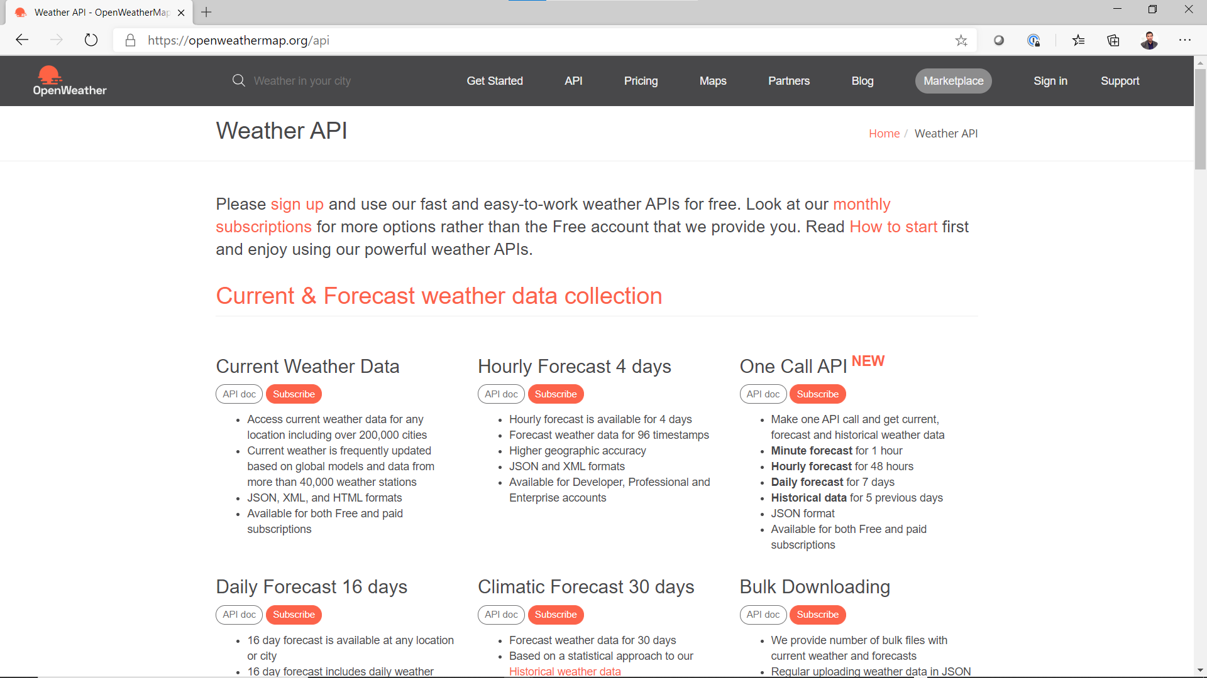
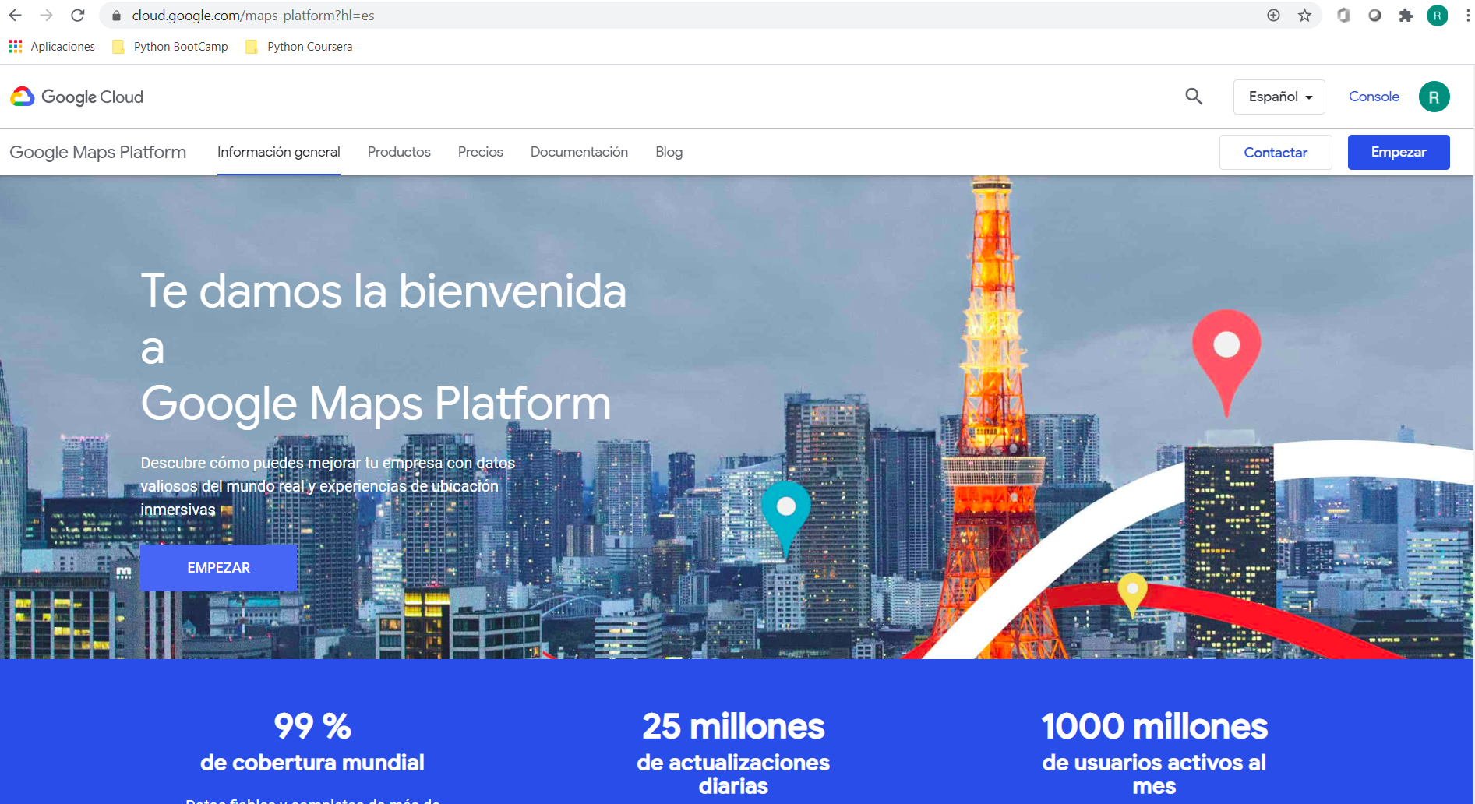
Title slide.
How we get tourism locations for latitude and longitude and city official city name
openweathermap.org
How we extract: (1) City hotel locations by city, (2) Map places, and (3) Plot heat maps
cloud.google.com

Slide 10
03. Define strategic metrics

Slide 11
Strategic metrics to be analyzed
x%
y% rate
n% index
Occupation rate on the hospitality sector and airline airport arrivals as a reference per selected cities
Time frame to be analyzed: 2018, 2019, 2020
%Unemployment index impact on the hospitality sector by selected cities

Slide 12

Let’s go coding for:
4. Plan data retrieval
5. Build data retrieval
6. Assemble and clean
7. Analyze trends

Slide 13
Our limitations
Mexico lacks official data for strong analysis and updated data
INEGI APIs are not user friendly
Mexico local data does not match with international definitions
08. Acknowledge limitations

Slide 14
09. Tell the story

Slide 15
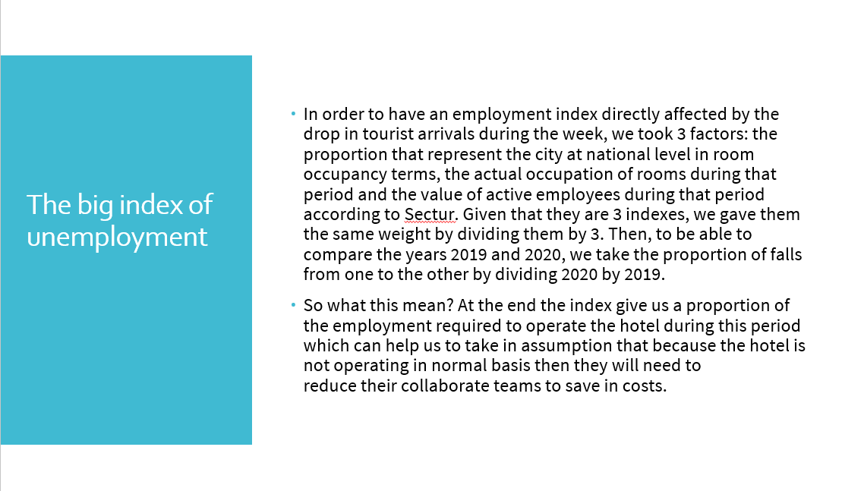

Slide 16
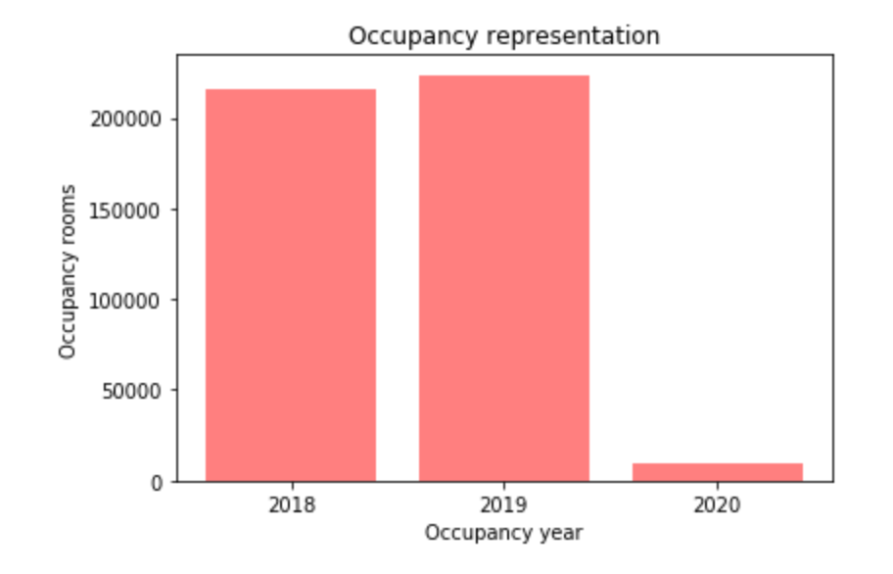
Hotel occupancy
Based in the last 3 years we analyze how the occupancy has been.
Increase of 4% from 2018 to 2019.
Decrease of 96% from 2019 to 2020

Slide 17
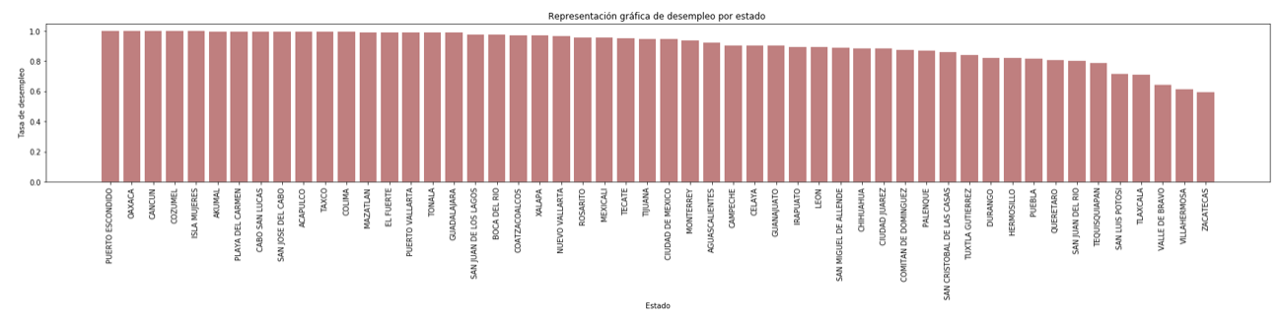
Unemployment
In the bar plot we present how unemployment affects each city in Mexico
The cities with higher unemployment are:
Puerto Escondido
Oaxaca
Cancun
Cozumel

Slide 18
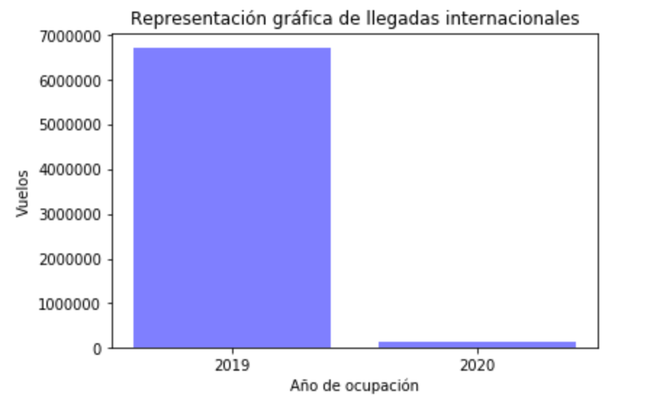
Airport arrivals
Based on the international flights we analyzed the decrease in tourism
Decrease of 98% from 2019 to 2020

Slide 19
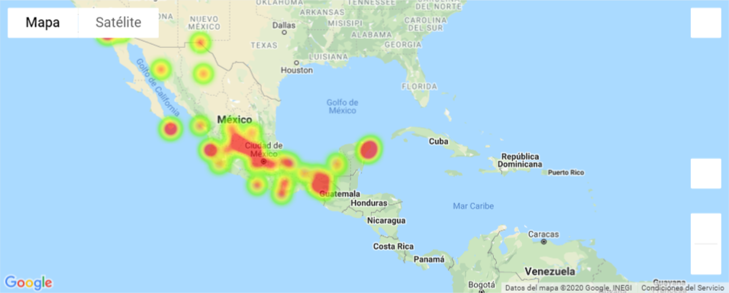
MEXICO HAS BEEN DRAMATICALLY IMPACTED ON ITS TOURISM INDUSTRY
Small and medium size cities has a lower impact vs beach destinations

Slide 20
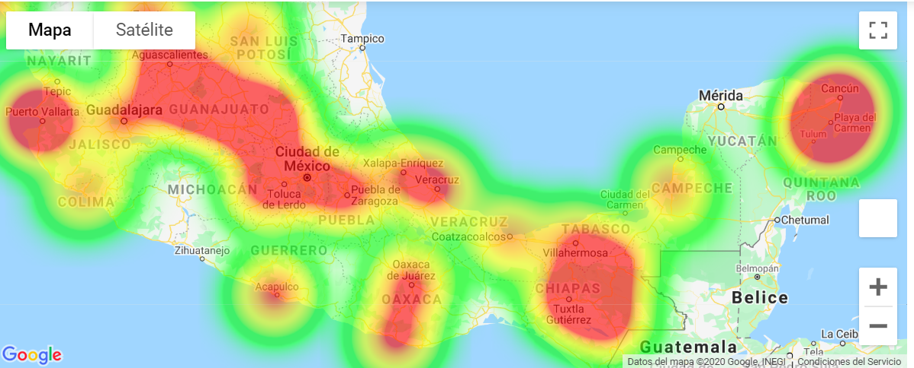

Slide 21
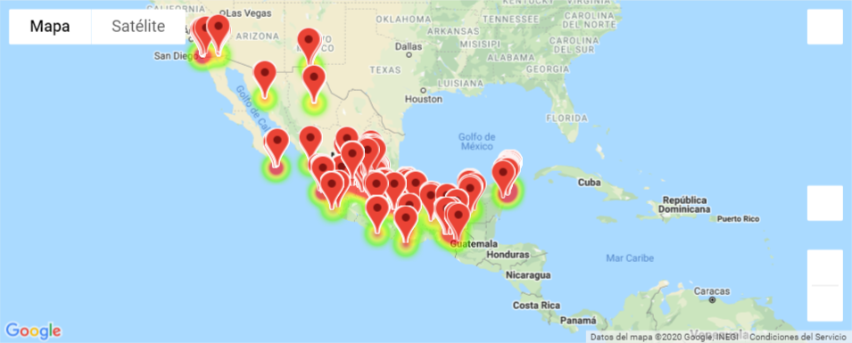

Slide 22
Slide 5
The final story
Challenges
Mexico lacks official data for strong analysis and updated data
INEGI APIs are not user friendly
Mexico local data does not match with international definitions
Approach
We use tourism as our main source of analysis since it represents the 9% of economy
We use hotel room occupation as an indirect method to calculate unemployment metrics
We use top cities in the country as a representative sample of analysis
Conclusions
Top 5 cities impacted are: Puerto Escondido, Oaxaca, Cancún, Cozumel, Isla Mujeres
The occupation rate drops 96% vs last year.
The international arrivals drop to 98% on the holly week period.
We estimate that 4.3M of direct employments were affected during holy week, partially or even totally.
Learnings
Data quality and data extraction is the top challenge
Availability of data sources and correct data formats is a most
Data cleansing is a first step process. If data cleansing is not done correctly, we are going to run into many errors

Slide 23
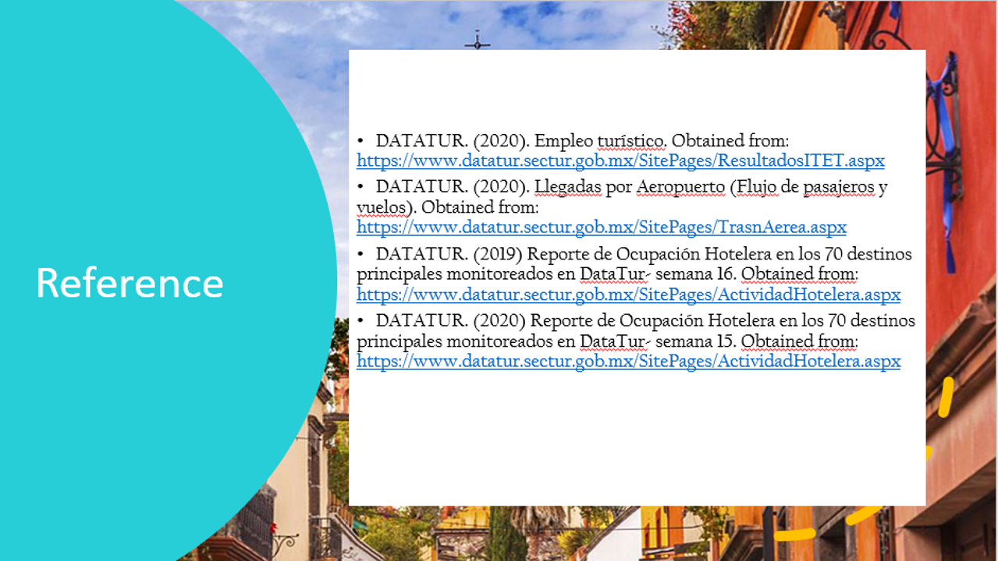

Slide 24
Thank You
Questions are welcome – Plaese do not be so rude with us!!!

